Slide 1

Bank Marketing Campaign
Data Analysis
Thesis for the exam of Data Spaces
Academic Year 2020/21
Student: Marigo Tommaso

Slide 2

INDEX
Introduction
Dataset Analysis
Classification Models
Comparison & Conclusions
Final Remarks
2

Slide 3
INTRODUCTION
3

Slide 4
1 – INTRODUCTION
The Work
In this work the Bank Marketing Dataset was analyzed, which can be downloaded free of charge from the UCI Machine Learning Repository:
https://archive.ics.uci.edu/ml/datasets/bank+marketing
The dataset collects information from customers of a Portuguese bank between May 2008 and November 2010 during a marketing campaign conducted by the bank, carried out by telephone on its customers. The bank has proposed to its customers a subscription for a term deposit.
4

Slide 5
1 – INTRODUCTION
The Work
The goal of the study was to provide an accurate classifier that would allow the bank to contact those customers most likely to subscribe.
The work was conducted with Python 3.8 with the help of the following libraries:
Pandas and Numpy for data structures.
Imblearn for rebalancing algorithm.
Sklearn for classification algorithms.
Matplotlib and Seaborn for the realization of the graphs.
5

Slide 6
DATASET ANALYSIS
6

Slide 7
2 – DATASET ANALYSIS
Variables
Customer Information:
age: age of client (numeric).
job: type of job (categorical).
marital: marital status (categorical).
education: level of education (categorical).
default: whether the customer has a default credit or not (binary).
housing: whether the customer has a housing loan or not (binary).
loan: whether the customer has a loan or not (binary)
Information on the last contact during the marketing campaign:
contact: contact communication type (categorical).
month: last contact month of year (categorical).
day_of_week: last contact day of the week (categorical).
duration: last contact duration, in seconds (numeric).
7

Slide 8
2 – DATASET ANALYSIS
Variables
Other attributes:
campaign: number of contacts performed during this campaign and for this client (numeric).
pdays: number of days that passed by after the client was last contacted from a previous campaign.
previous: number of contacts performed before this campaign and for this client (numeric).
outcome: outcome of the previous marketing campaign (categorical).
Social and economic context attributes:
emp.var.rate: employment variation rate - quarterly indicator (numeric).
cons.price.idx: consumer price index - monthly indicator (numeric).
cons.conf.idx: consumer confidence index - monthly indicator (numeric).
euribor3m: euribor 3 month rate - daily indicator (numeric).
nr.employed: number of employees - quarterly indicator (numeric).
Output variable (desired target):
y: has the client subscribed a term deposit? (binary: “yes”, “no”).
8

Slide 9
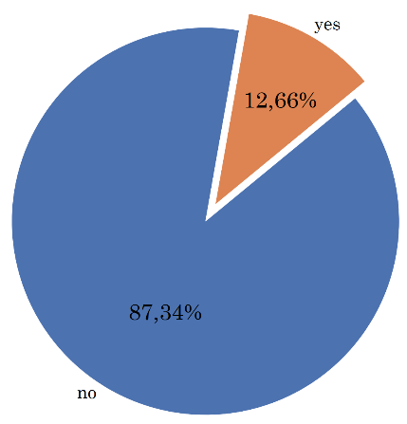
2 – DATASET ANALYSIS
Preliminary considerations
The dataset is composed of 41188 records.
Highly unbalanced dataset. Only 4640 said yes.
Preliminarily I chose to ignore missing values.
The following attributes were removed from the analysis:
month and day_of_week: redundant for classification.
duration: this is a value known only after the call.
9

Slide 10
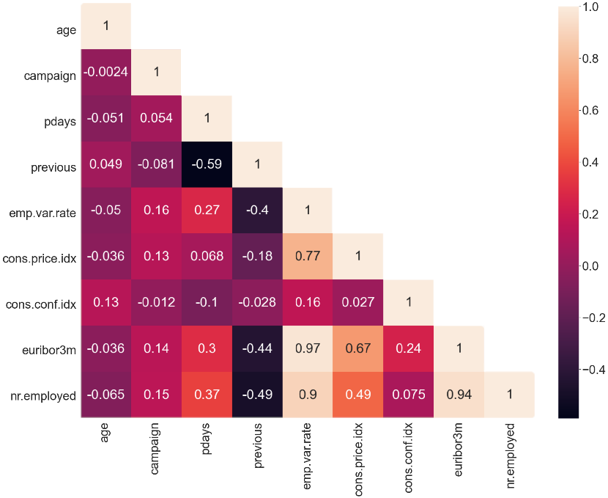
2 – DATASET ANALYSIS
Numeric Variables
Correlation Matrix with Pearson index
10

Slide 11
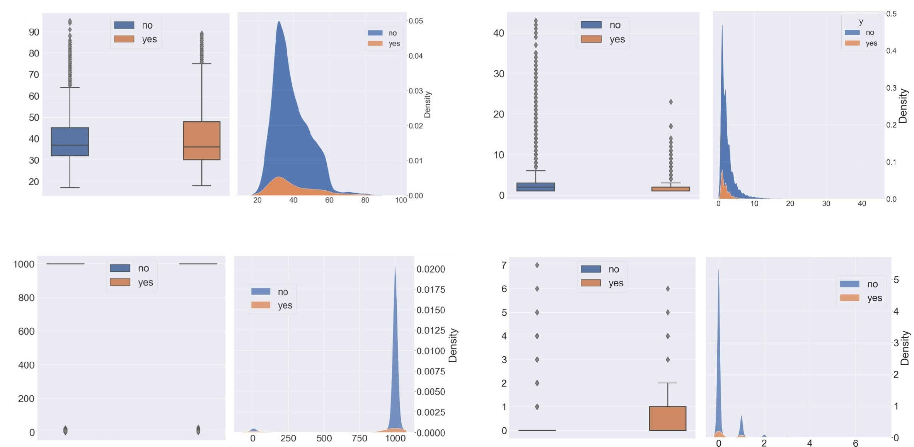
2 – DATASET ANALYSIS
Numeric Variables
Age
Campaign
Previous days
Previous contacts
11

Slide 12
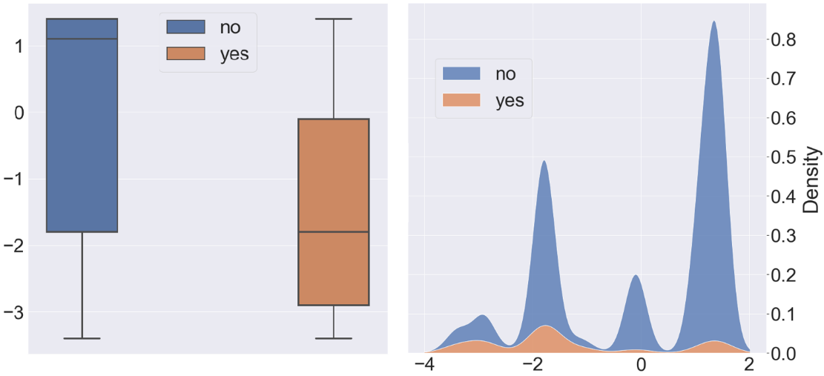
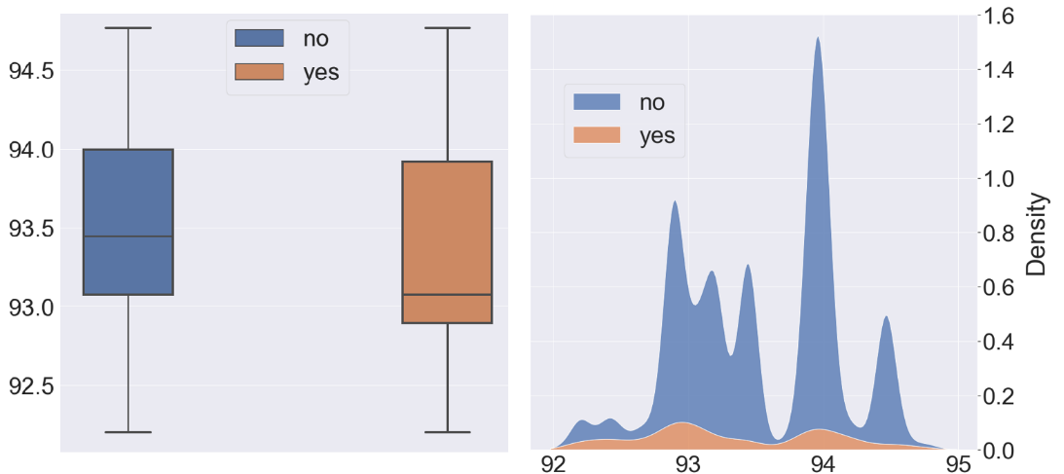
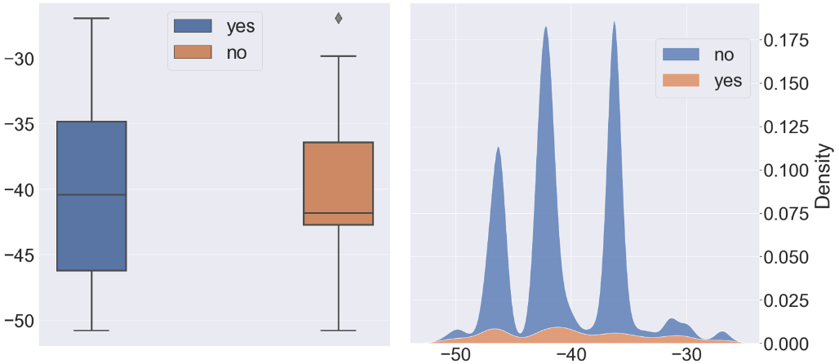
2 – DATASET ANALYSIS
Numeric Variables
Employment Variation Rate
Consumer Price Index
Consumer Confidence Index
12

Slide 13
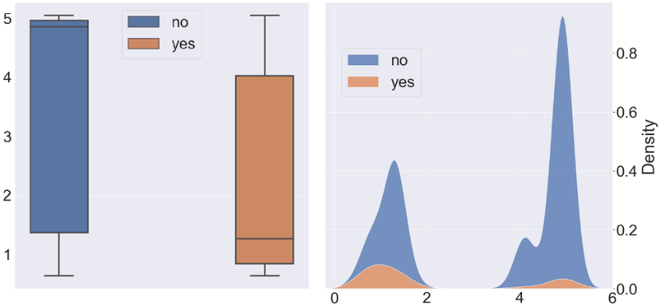
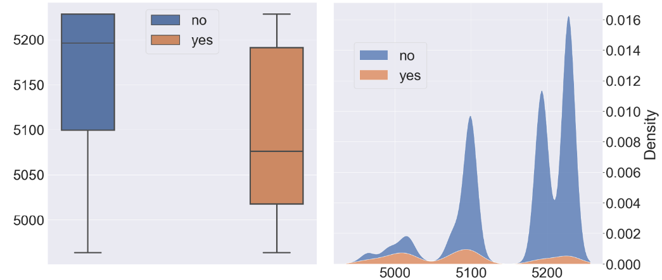
2 – DATASET ANALYSIS
Numeric Variables
Euribor
Number of Employees
13

Slide 14
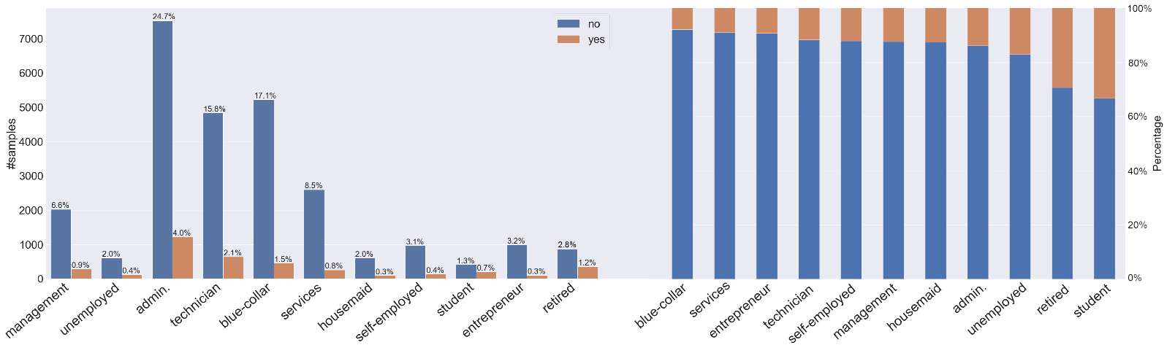
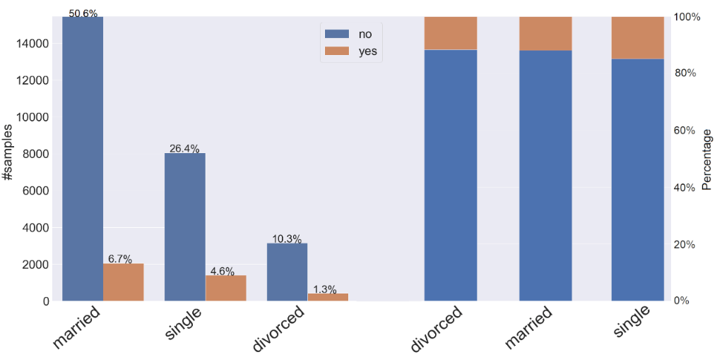
2 – DATASET ANALYSIS
Categorical Variables
Job
Marital
14

Slide 15
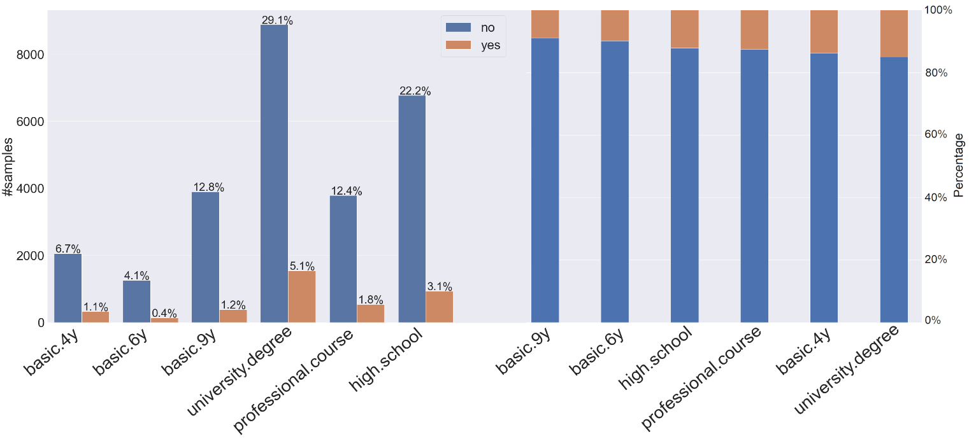
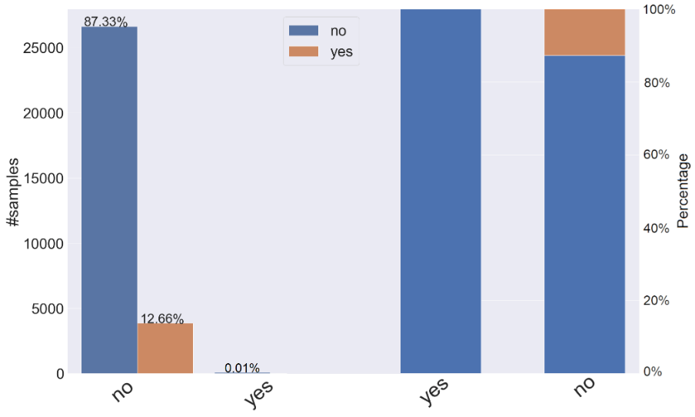
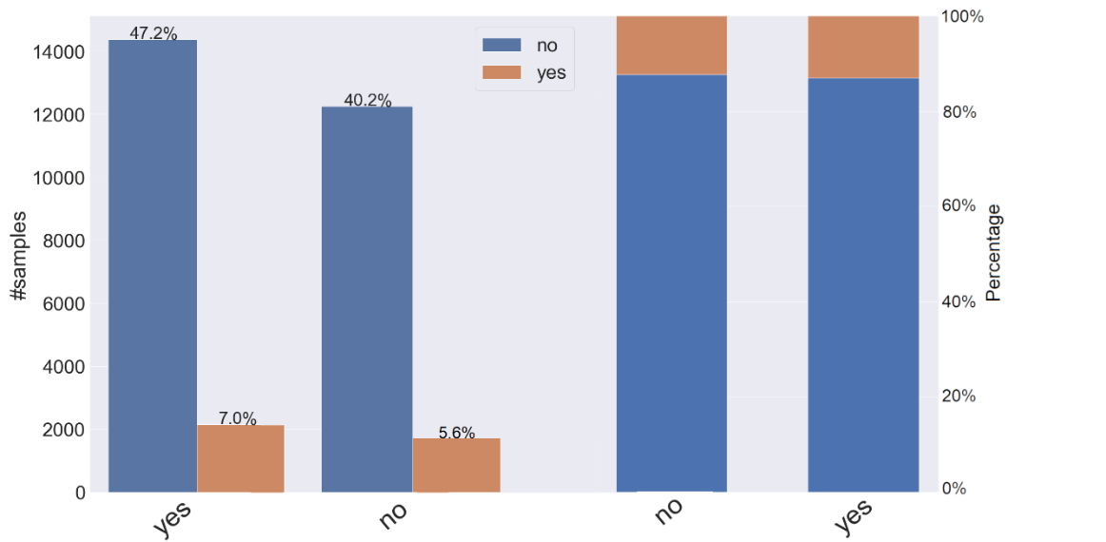
2 – DATASET ANALYSIS
Categorical Variables
Education
Default
Housing
15

Slide 16
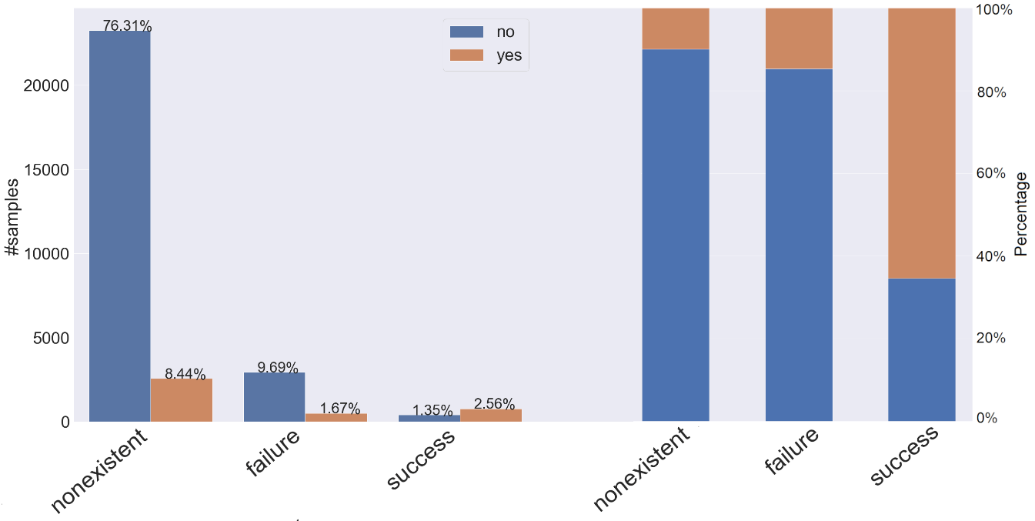
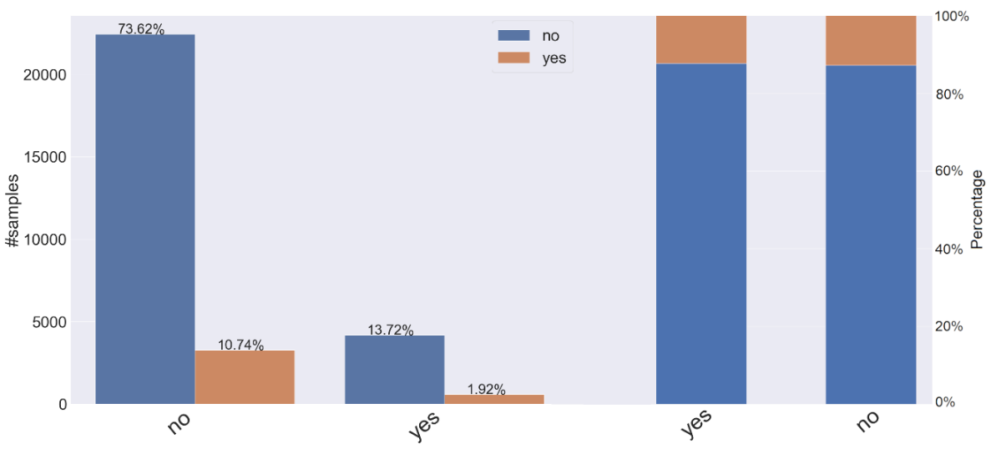
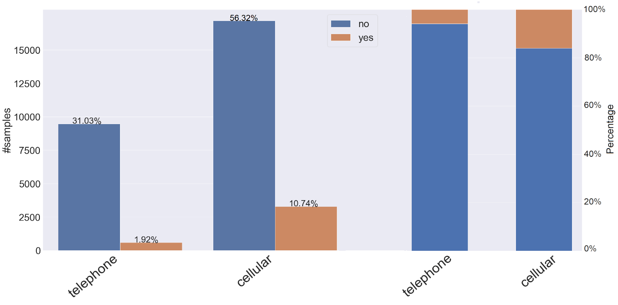
2 – DATASET ANALYSIS
Categorical Variables
Previous Outcome
Loan
Contact
16

Slide 17
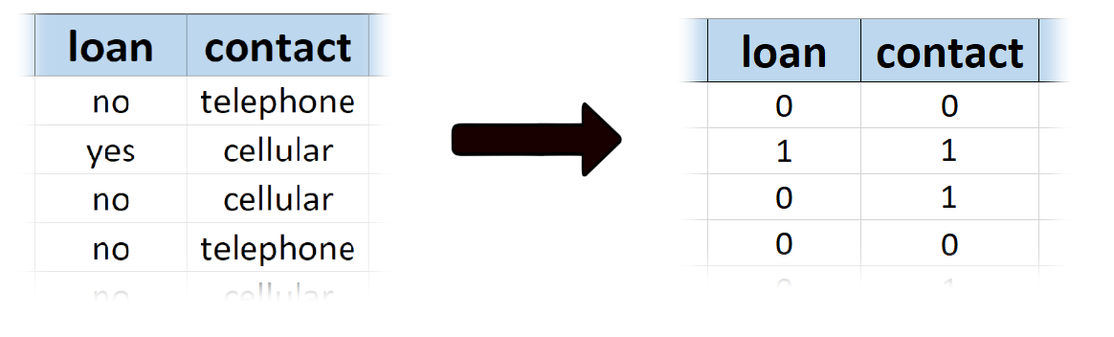
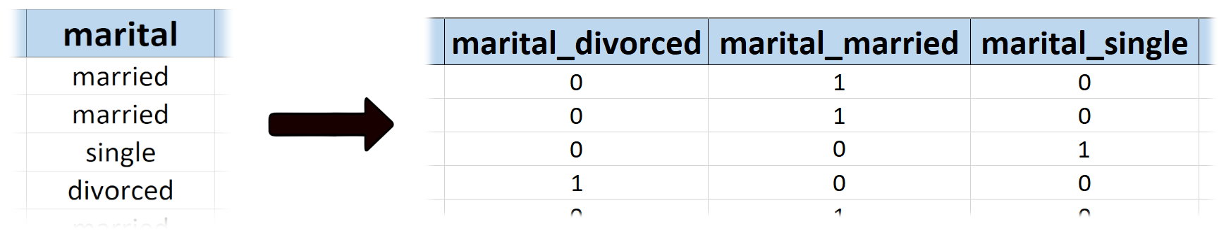
2 – DATASET ANALYSIS
Data Preprocessing
Elimination of the default variable.
LabelEncoder for binary variables.
OneHotEncoder for categorical variables.
LabelEncoder
OneHotEncoder
17

Slide 18
2 – DATASET ANALYSIS
Data Preprocessing
In summary, the dataset will have the following characteristics:
38245 records.
No missing values.
37 variables: 9 numeric and 27 binary.
18

Slide 19
CLASSIFICATION MODELS
19

Slide 20
3 – CLASSIFICATION MODELS
Classifiers
For our analysis, the following models were chosen:
Logistic Regression
K-Nearest Neightbors
Decision Tree
Random Forest
Support Vector Machine
Tuning phase with K-Fold Cross Validation:
Test set 10%
Validation set 15%
20

Slide 21
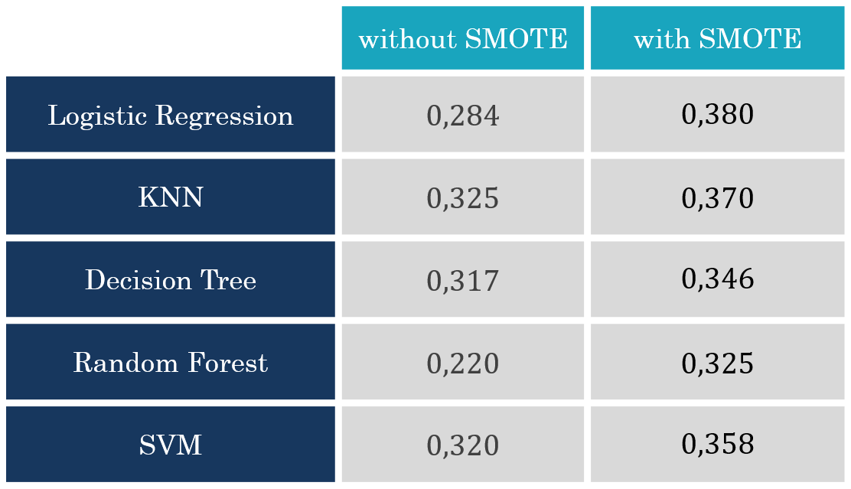
3 – CLASSIFICATION MODELS
SMOTE
The SMOTE technique was used to rebalance the dataset.
F1-score
21

Slide 22
3 – CLASSIFICATION MODELS
Logistic Regression
A tuning phase will be performed on the following sets of hyperparameters:
Penalty in [ l1 , l2 ]: the type of penalty in the cost function.
C in [ 100, 10, 1.0, 0.1, 0.01 ]: inverse of regularization strength.
The values obtained are:
Penalty = l1
C = 10
22

Slide 23
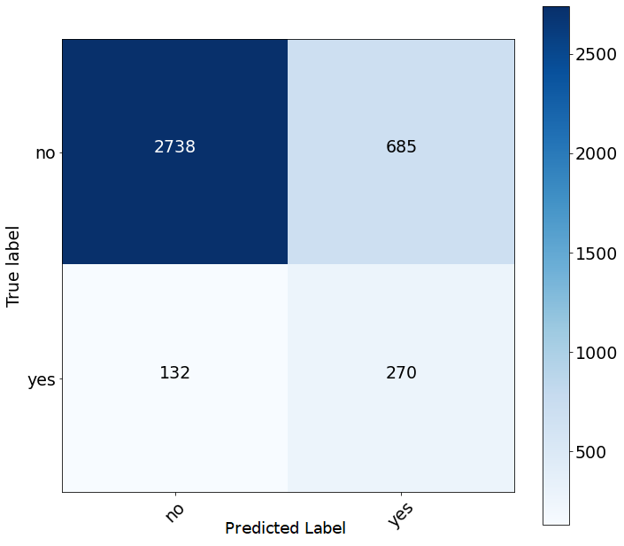
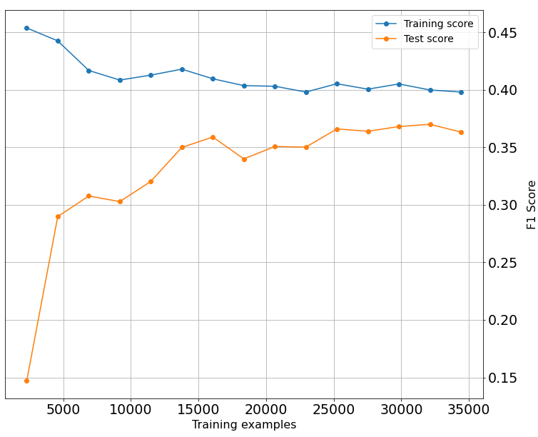
3 – CLASSIFICATION MODELS
Logistic Regression
On the test set I got an accuracy of 0.79.
Confusion Matrix
Learning Curve
23

Slide 24
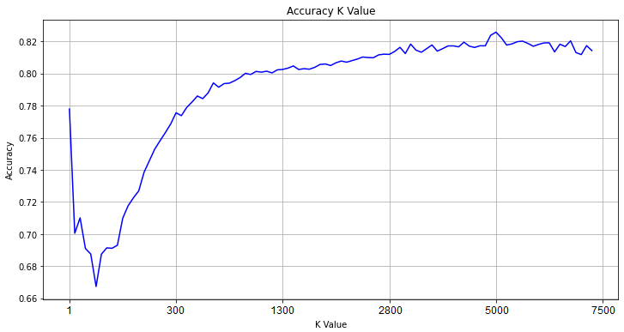
3 – CLASSIFICATION MODELS
K-Nearest Neighbor
The only set of hyperparameters used for the tuning phase are the values of K:
K in [ 1, 4, 7, 13, … ,1876,1951,2029, … ,7204, 7351 ]: the number of nearest closest neighbors.
The value obtained is:
K = 4921
Tuning Phase on Validation set
24

Slide 25
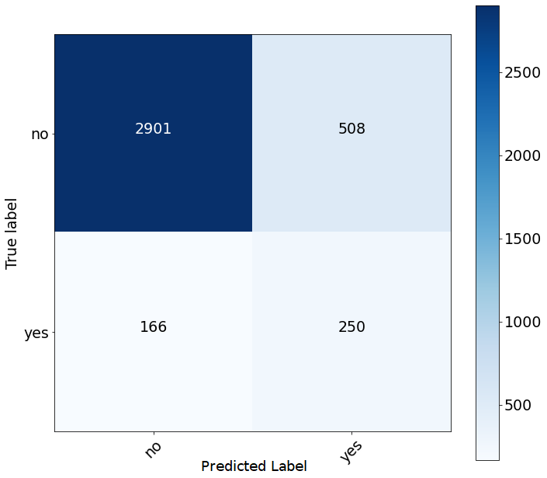
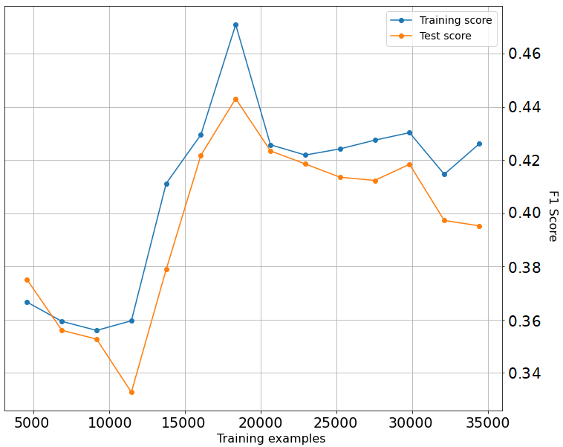
3 – CLASSIFICATION MODELS
K-Nearest Neighbor
The accuracy value obtained is 0.82.
Confusion Matrix
Learning Curve
25

Slide 26
3 – CLASSIFICATION MODELS
Decision Tree
The hyperparameter sets for the tuning phase are as follows:
Criterion in [ “gini”, “entropy” ]: type of impurity measurement.
Max_depth in [ 15, 20, 25, 30, 35, 40, 45, 50, 60, 65, 70, 75 ]: the maximum depth of the tree.
Min_samples_splits in [ 4, 6, 8, 10, 12, 14, 16, 18, 20 ]: the minimum number of samples in a node to
The value obtained is:
Criterion = gini
Max_depth = 15
Min_samples = 6
be considered for further splitting.
26

Slide 27
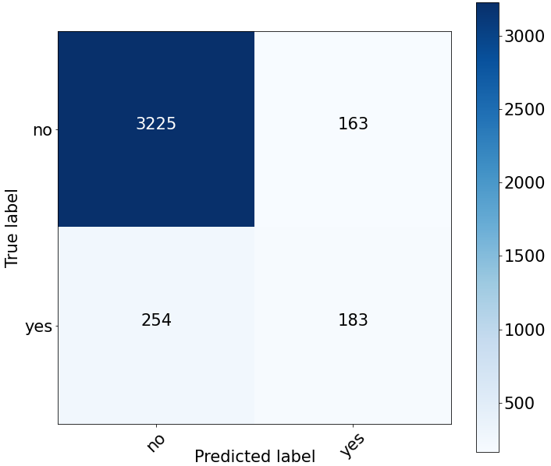
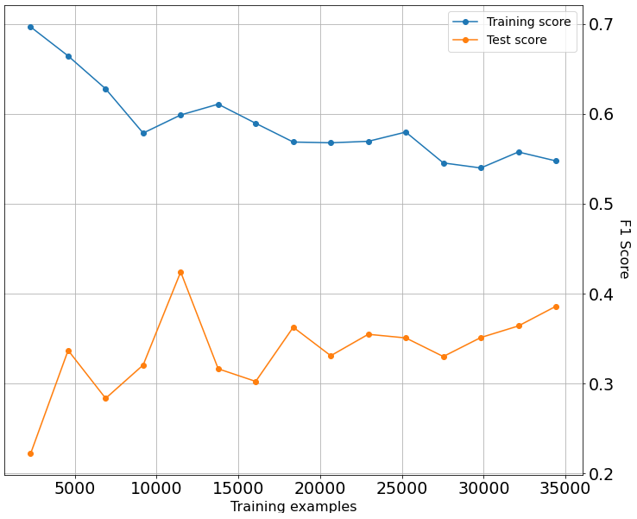
3 – CLASSIFICATION MODELS
Decision Tree
The accuracy value obtained is 0.89.
Confusion Matrix
Learning Curve
27

Slide 28
3 – CLASSIFICATION MODELS
Random Forest
The hyperparameter sets for the tuning phase are as follows:
N_estimators in [ 50, 100, 150, … , 850, 900 ]: numbers of trees.
Criterion in [ “gini”, “entropy” ]: type of impurity measurement.
Max_depth in [ 15, 20, 25, 30, 35, 40, 45, 50, 60, 65, 70, 75 ].
Min_samples_splits in [ 4, 6, 8, 10, 12, 14, 16, 18, 20 ].
The value obtained is:
N_estimtors = 400
Criterion = entropy
Max_depth = 10
Min_samples = 2
28

Slide 29
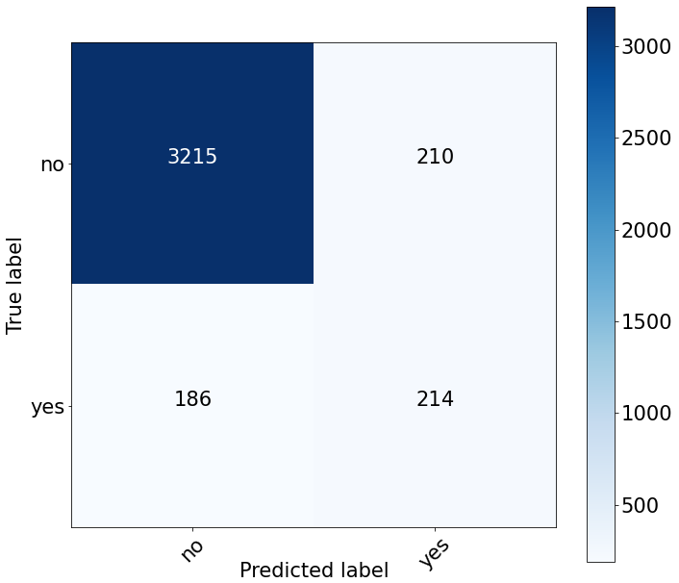
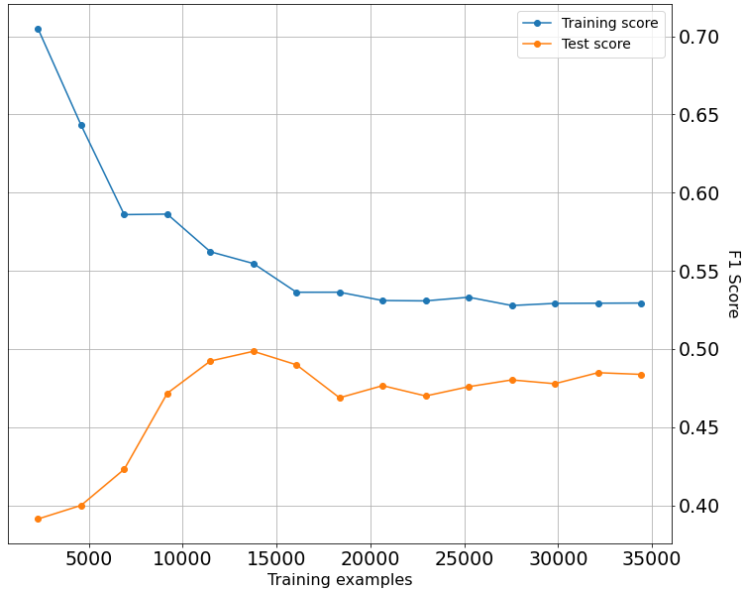
3 – CLASSIFICATION MODELS
Random Forest
The accuracy value obtained is 0.90.
Confusion Matrix
Learning Curve
29

Slide 30
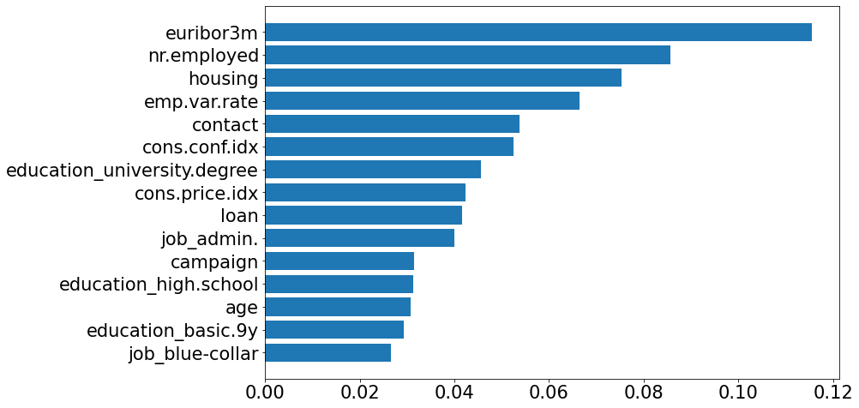
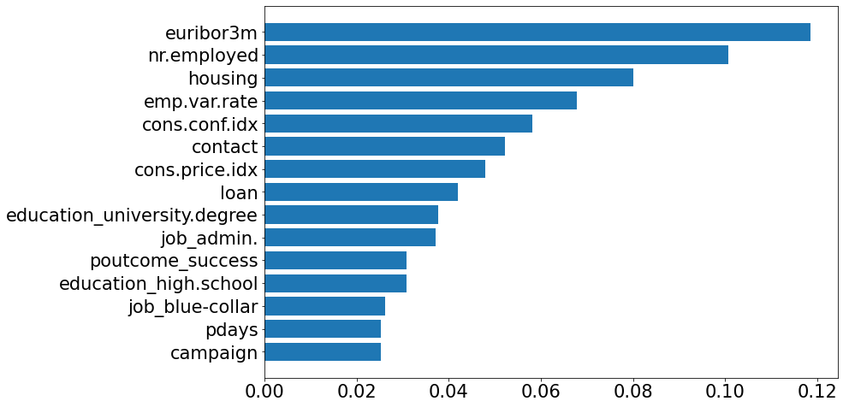
3 – CLASSIFICATION MODELS
DT and RF Features Importance
Decision Tree
Random Forest
30

Slide 31
3 – CLASSIFICATION MODELS
Support Vector Machine
The hyperparameter sets for the tuning phase are as follows:
C in [ 0.01, 0.1, 1, 10, 100, 1000 ]: inverse of regularization strength.
Gamma in [ 0.0001, 0.001, 0.01, 0.1 ]: gamma value in Kernel function.
The value obtained is:
Gamma= 0,001
C = 0,1
31

Slide 32
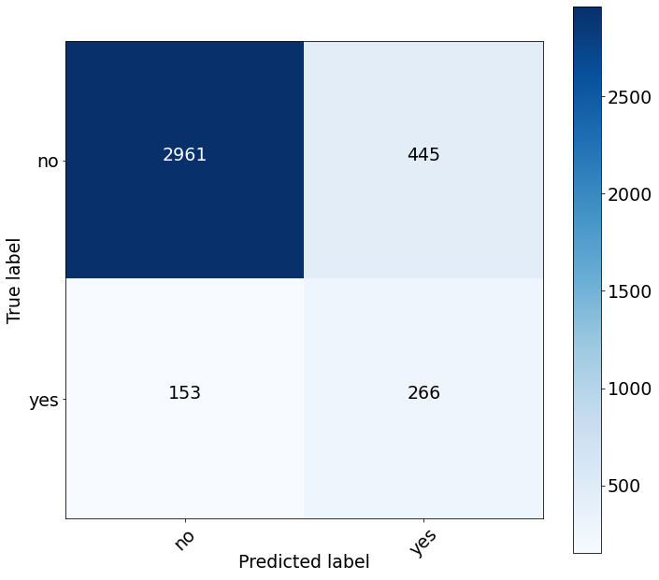
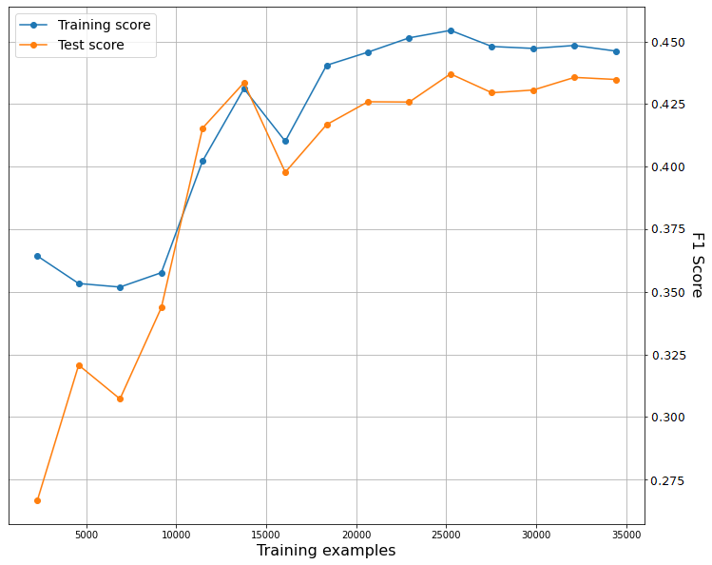
3 – CLASSIFICATION MODELS
Support Vector Machine
The accuracy value obtained is 0.84.
Confusion Matrix
Learning Curve
32

Slide 33
COMPARISON & CONCLUSIONS
33

Slide 34
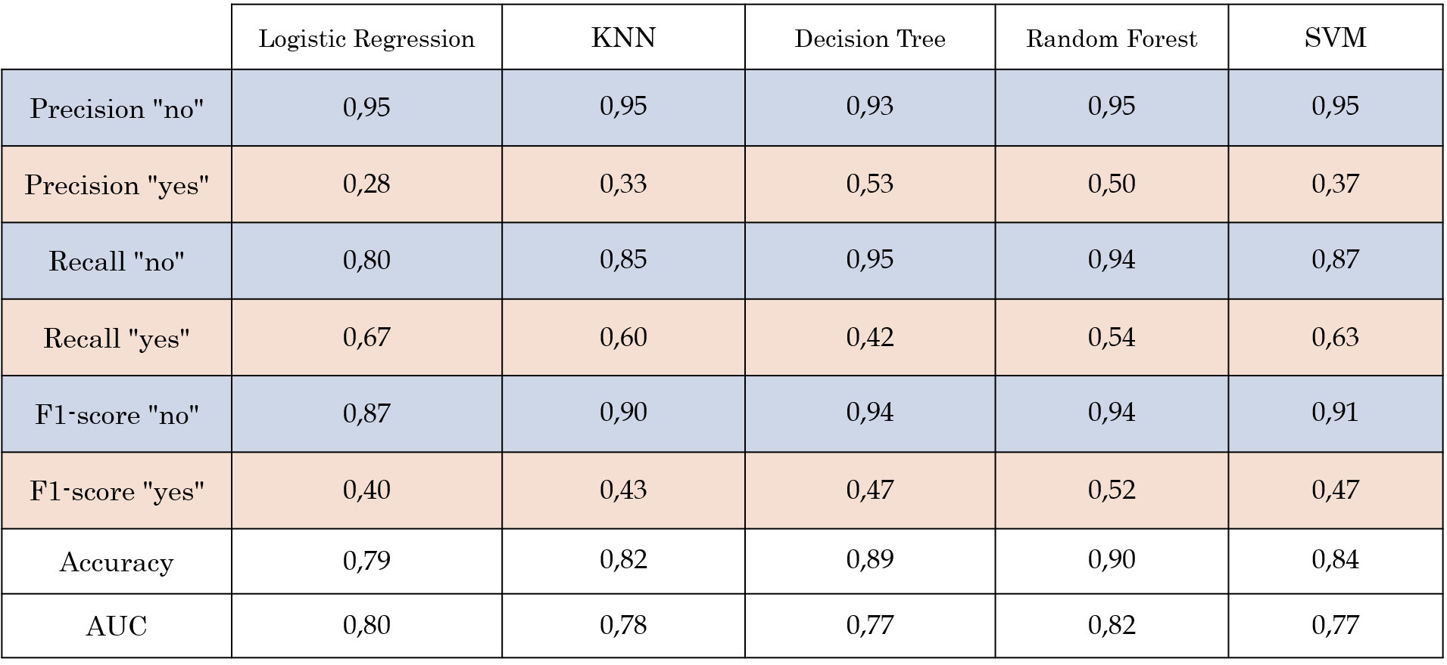
4 – COMPARISON & CONCLUSIONS
Report
Use Random forest for the classification.
Increase the number of calls when the variables on the socio-economic context are low.
34

Slide 35
FINAL REMARKS
35

Slide 36
5 – FINAL REMARKS
Remarks
SMOTE has improved the f1-Score and the recall of all the models. But the precision value decreases by about 5 points for Random Forest and Decision Tree, 10 points for SVM and by about 30/40 point for Logistic Regression and KNN.
The "duration" variable allowed all models to increase all metrics by 10/15 points and obtain an average AUC value of 0.96. Both Decision Tree and Random Forest have considered this variable as the most important.
36

